Slide 1
CSS

Slide 2
What we cover
Box model
Felx box layout

Slide 3
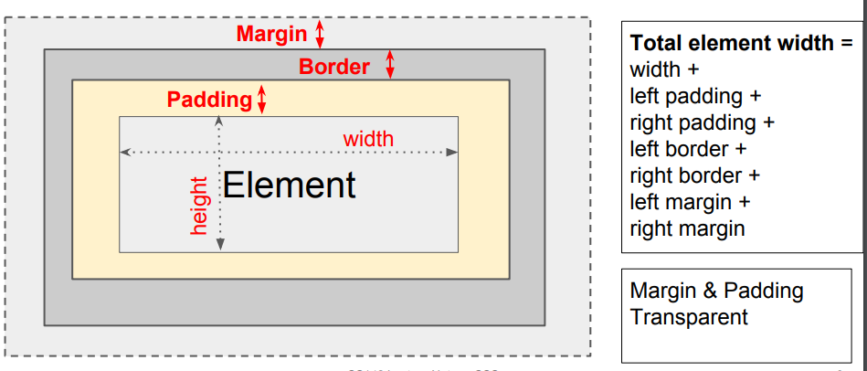
CSS box model
Every HTML element follows the CSS box model. You can change the text content, padding, border and margin for each tag.

Slide 4
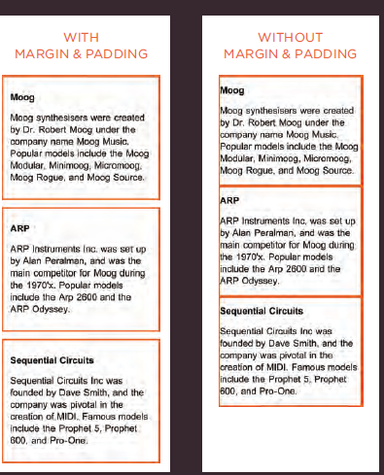
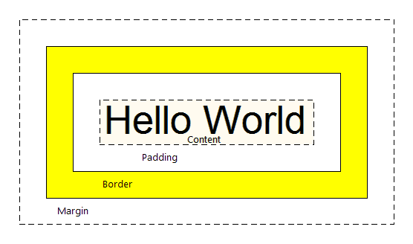
Example

Slide 5
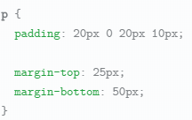
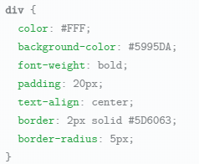
Examples

Slide 6
CSS3 improvement
Border image
Border shadow
Rounded corners
Elliptical shapes
{ moz-border-image: url("images/dots.gif")
11 11 11 11 stretch; }
border-top-right-radius : _px
border-bottom-right-radius : _px
border-bottom-left-radius: _px
border-top-left-radius: _px
Notes:
The border-image property
applies an image to the border of
any box. It takes a background
image and slices it into nine
pieces.
1: The URL of the image
2: Where to slice the image
3: What to do with the straight
edges; the possible values are:
stretch stretches the image
repeat repeats the image
round like repeat but if the
tiles do not fit exactly, scales
the tile image so they will

Slide 7
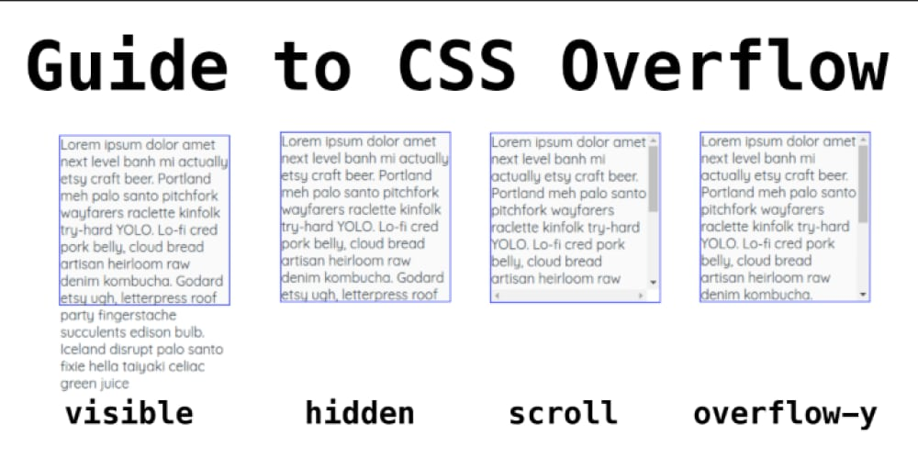
CSS overflow
p.one {
overflow: hidden;}
p.two {
overflow: scroll;}

Slide 8
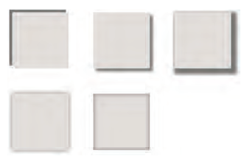
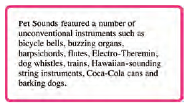
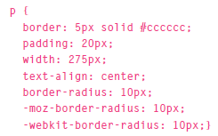
Css3 improvements
Box shadow - Find the code to do this to a paragraph
Rounded corners

Slide 9
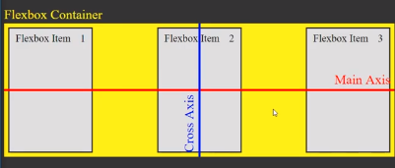
Flexbox
Flexbox stands for flexible box where your content can be organized properly in a modern web page. It uses two types of boxes : “flex containers” and “flex items”.
The job of a flex container is to group a bunch of flex items together and define how they’re positioned.
The Flexbox Layout (Flexible Box) module (https://www.w3.org/TR/css-flexbox-1/ ) aims at providing a more efficient way to lay out, align and distribute space among items in a container, even when their size is unknown and/or dynamic (thus the word "flex").
A flex container expands items to fill available free space, or shrinks them to prevent overflow.
Flexbox is direction-agnostic as opposed to the regular layouts (block which is vertically-based and inline which is horizontally-based).
Flexbox layout is most appropriate to the components of an application, and small-scale layouts, while the Grid layout is intended for larger scale layouts.

Slide 10
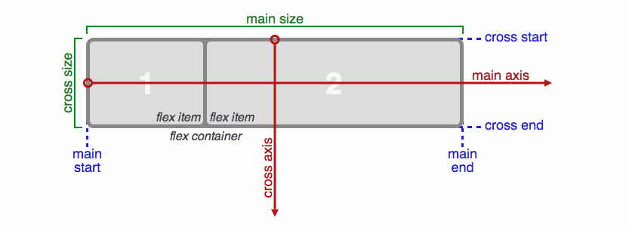
Directions
The flex layout is based on "flex-flow directions".

Slide 11
Explanation of directions
Items will be laid out following either the main axis (from main-start to main-end) or the cross axis (from cross-start to cross-end).
main axis - The main axis of a flex container is the primary axis along which flex items are laid out. Beware, it is not necessarily horizontal; it depends on the flex-direction property
main-start | main-end - The flex items are placed within the container starting from main-start and going to main-end.
main size - A flex item's width or height, whichever is in the main dimension, is the item's main size. The flex item's main size property is either the ‘width’ or ‘height’ property, whichever is in the main dimension.
cross axis - The axis perpendicular to the main axis is called the cross axis. Its direction depends on the main axis direction.
cross-start | cross-end - Flex lines are filled with items and placed into the container starting on the cross-start side of the flex container and going toward the cross-end side.
cross size - The width or height of a flex item, whichever is in the cross dimension, is the item's cross size. The cross size property is whichever of ‘width’ or ‘height’ that is in the cross dimension.

Slide 12
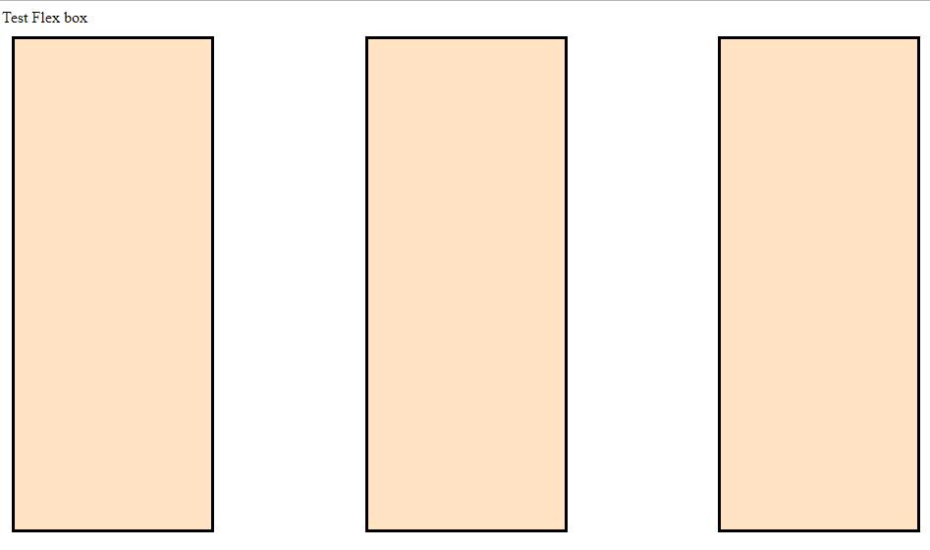
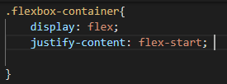
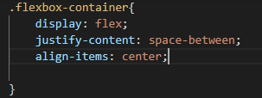
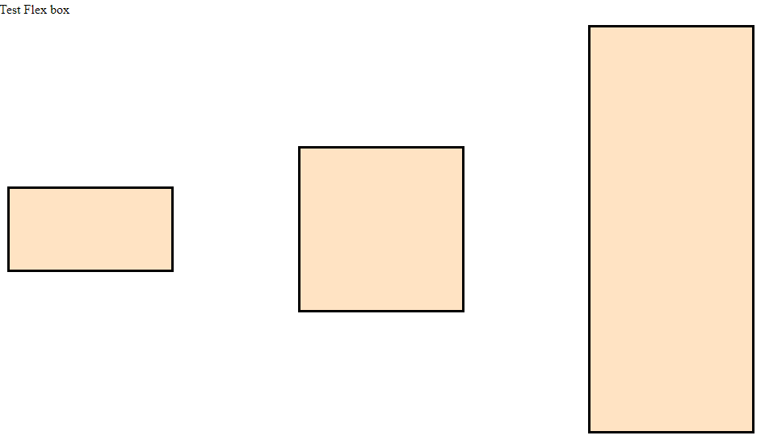
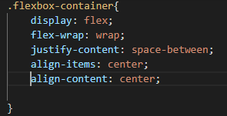
Working code ☺
IF we need to align them in main axis (horizontically) use justify-content. Align-items : gives you the original size
Justify-content : deals with main axis
Align-items : deals with cross axis, give the space
Align-items : gives you the original size
Resize the html page and check what happens

Slide 13
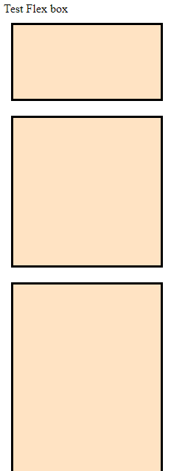

Working code ☺
IF we need to align them in cross axis (vertically) use flex-direction

Slide 14
Download and Open our example
We will be adding styles to the <div id=“boxContainer">
Open the folder in vs code and check the boxes.html and flex.css

Slide 15

Our example – adding flex
Add display: flex; to the #boxContainer
Test the page
Give the boxContainer a direction (try each value in dev tools to see the difference)
flex-direction: row;
Try the other values in dev tools to see the difference
row-reverse: right to left
column: top to bottom
column-reverse: bottom to top

Slide 16
Our Example - Wrapping the contents
Add in flex-wrap:nowrap; to #boxContainer
nowrap (default): all flex items will be on one line
wrap: flex items will wrap onto multiple lines, from top to bottom.
wrap-reverse: flex items will wrap onto multiple lines from bottom to top.
Try each one in dev tools to see the difference (change the size of the browser to see what happens)

Slide 17
Shorthand
flex-flow is a shorthand flex-direction and flex-wrap properties, which together define the flex container's main and cross axes. Default is row nowrap.
flex-flow: <‘flex-direction’> || <‘flex-wrap’>
What does flex-flow:column wrap-reverse; mean?

Slide 18
Our example – flex-flow
Remove the flex-wrap and flex-direction properties
Add in to the container flex-flow: row wrap;

Slide 19
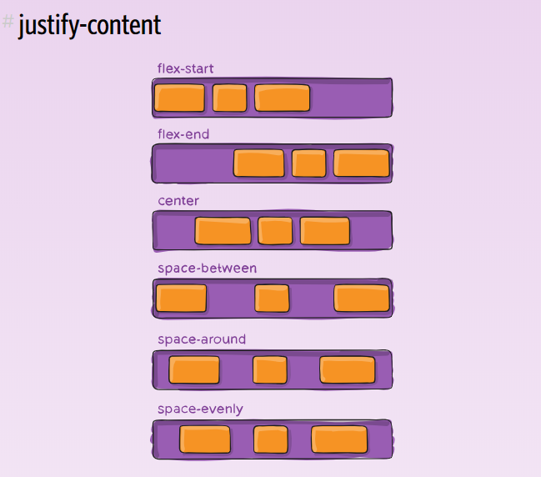
Spacing

Slide 20
Our example
Add in to #boxContainer
justify-content: flex-start;
Try each of the values below in dev tools to see the difference
flex-start (default): items are packed toward the start
flex-end: items are packed toward to end
center: items are centred
space-between: items are evenly distributed
first item is on the start line, last item on the end line
space-around: items are evenly distributed in the line with equal space around them.
space-evenly: items are distributed so that the spacing between any two items (and the space to the edges) is equal.

Slide 21
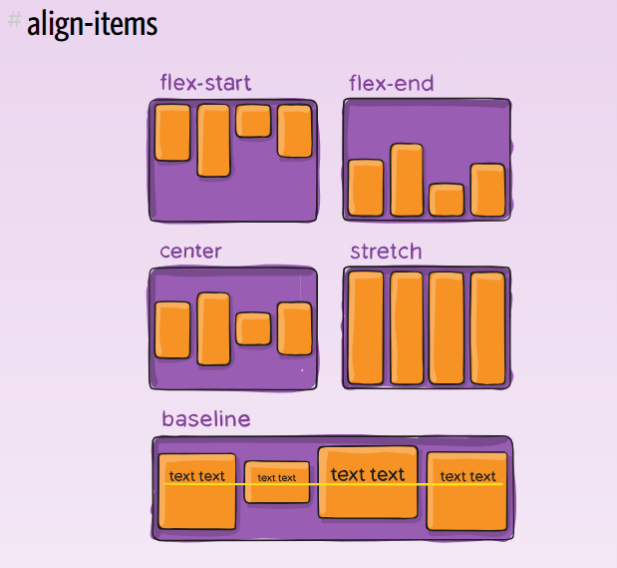
Aligning items
flex-start: cross-start margin edge of the items is placed on the cross-start line
flex-end: cross-end margin edge of the items is placed on the cross-end line
center: items are centered in the cross-axis
baseline: items are aligned such as their baselines align
stretch (default): stretch to fill the container (still respect min-width/max-width)

Slide 22
Our example
Add in some extra text in the HTML to some of the boxes so they are a different length
Add in to the CSS align-items:flex-start to #boxContainer
Try the other values in dev tools to see the difference
flex-end
center
baseline
stretch

Slide 23
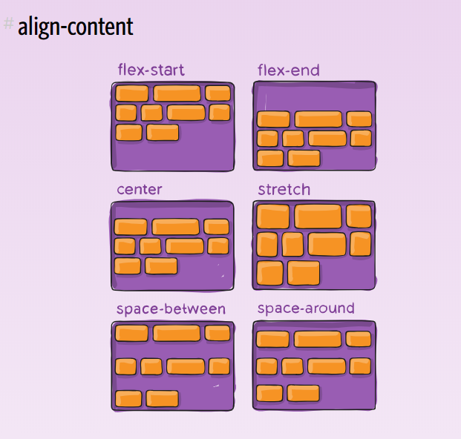
Aligning content
Another property you can set
flex-start: lines packed to the start of the container
flex-end: lines packed to the end of the container
center: lines packed to the center of the container
space-between: lines evenly distributed; the first line is at the start of the container while the last one is at the end
space-around: lines evenly distributed with equal space around each line
stretch (default): lines stretch to take up the remaining spaceparent

Slide 24
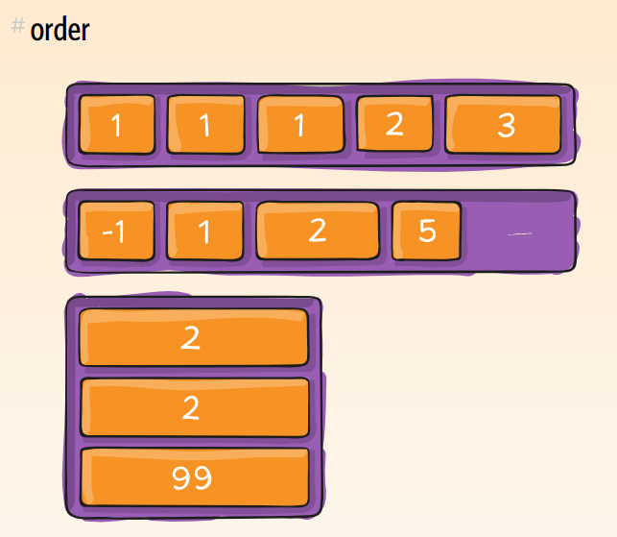
Order
You can change the order items are displayed by setting the property order on the CHILD you want to affect

Slide 25
Our Example – index.html
Change the #container style to the given one
Add in the following style
#first {
order:3;
}
Explain what that does
#container {
background-color:#6200ee;
padding: 0;
margin: 0;
display: flex;
flex-flow: row wrap;
justify-content: space-around;
align-items:stretch;
}
Resize the browser and check

Slide 26
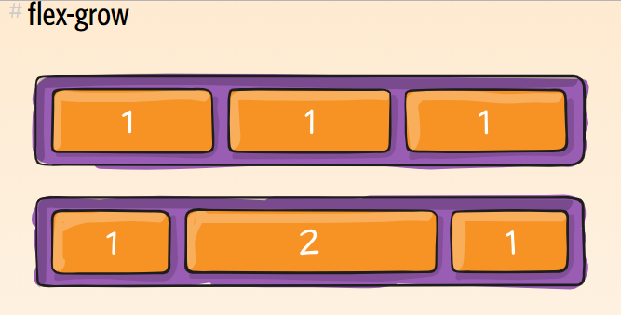
Flex-grow
This defines the ability for a flex item to grow if necessary. It accepts a unitless value that serves as a proportion. It dictates what amount of the available space inside the flex container the item should take up.
If all items have flex-grow set to 1, the remaining space in the container will be distributed equally to all children. If one of the children has a value of 2, the remaining space would take up twice as much space as the others (or it will try to, at least).

Slide 27
More details on flex
https://css-tricks.com/snippets/css/a-guide-to-flexbox/
https://developer.mozilla.org/en-US/docs/Web/CSS/CSS_Flexible_Box_Layout/Basic_Concepts_of_Flexbox

Slide 28
Other flex item properties
Flex-shrink - will tell whether a particular flex item shrinks or not when resizing
Flex-grow : – will divide the remaining space on the container
Here we give a number, 1,2 or 3
Aligh-self
Order – rearrange the order with out changing the html code

Slide 29
CSS - grid

Slide 30
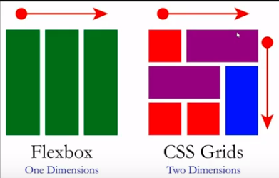
Introduction
Grid is similar to flex box but grid is allowing to define two dimension layout designs. Hence it is bit complex.

Slide 31
CSS Grid
CSS Grid Layout is the most powerful layout system available in CSS.
It is a 2-dimensional system, meaning it can handle both columns and rows, unlike flexbox which is largely a 1-dimensional system.
You work with Grid Layout by applying CSS rules both to a parent element (which becomes the Grid Container) and to that elements children (which become Grid Items).

Slide 32
CSS Grid (Useful resources)
CSS Tricks - https://css-tricks.com/snippets/css/complete-guide-grid/
Specification - https://www.w3.org/TR/css-grid-1/
Grid by example - https://gridbyexample.com/
MDN Guide - https://developer.mozilla.org/en-US/docs/Web/CSS/CSS_Grid_Layout

Slide 33
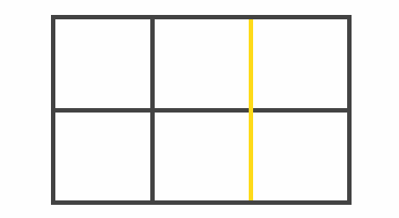
Grid Line
The dividing lines that make up the structure of the grid. They can be either vertical ("column grid lines") or horizontal ("row grid lines") and reside on either side of a row or column. Here the yellow line is an example of a column grid line.

Slide 34
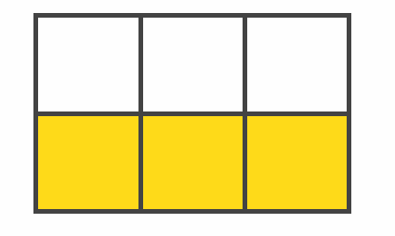
Grid Track
The space between two adjacent grid lines. You can think of them like the columns or rows of the grid. Here's the grid track between the second and third row grid lines.

Slide 35
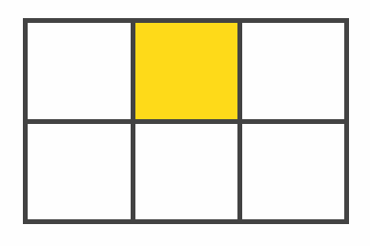
Grid Cell
The space between two adjacent row and two adjacent column grid lines. It's a single "unit" of the grid. Here's the grid cell between row grid lines 1 and 2, and column grid lines 2 and 3.

Slide 36
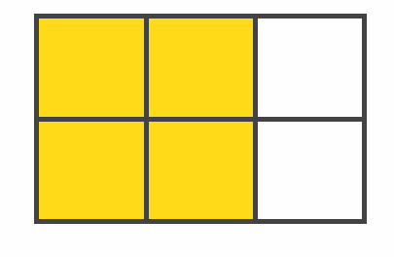
Grid Area
The total space surrounded by four grid lines. A grid area may be comprised of any number of grid cells. Here's the grid area between row grid lines 1 and 3, and column grid lines 1 and 3.

Slide 37
Our example
Create a new css named “grid.css” in the project.
Link it to the boxes.html page
Copy and paste all the styles except the Flex styles.

Slide 38
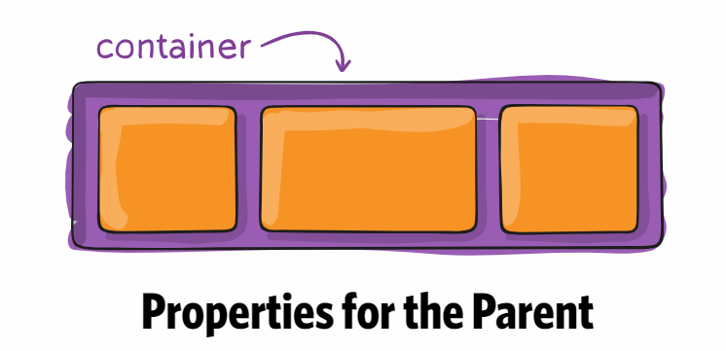
<div id=“#boxContainer">

Slide 39
Adding Grid and specifying the size
Add display: grid; to the #boxContainer to make its contents into a grid
To specify the size
grid-template-columns
grid-template-rows
Add the following to the #boxContainer
grid-template-columns: 200px 300px 200px 300px;
grid-template-rows: 450px 200px;
Lets look at the results

Slide 40
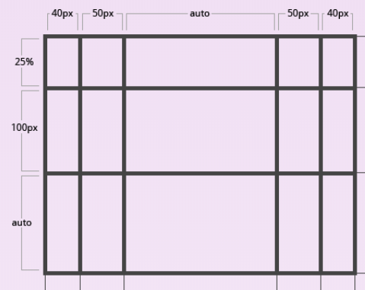
Grid Definition (cont)
You can also use % and auto to set the sizes
For example, change your grid definition to
grid-template-columns: 40px 50px auto 50px 40px;
grid-template-rows: 25% 100px auto;
Try these different values

Slide 41
Grid definition (cont)
You can also use the repeat keyword to add the size
Change the grid to
grid-template-columns: repeat(5,100px);
grid-template-rows: repeat(3,400px);
Try this and observe the page
grid-template-columns: repeat(5,auto);
grid-template-rows: repeat(3,auto);

Slide 42
You can also use the auto keyword
Change your template to
grid-template-columns: repeat(3,150px);
grid-template-rows: repeat(2,100px) 300px auto;

Slide 43
The fr unit
The fr unit allows you to set the size of a track as a fraction of the free space of the grid container. For example, this will set each item to one third the width of the grid container:
grid-template-columns: 1fr 1fr 1fr;
OR
grid-template-columns: repeat(3,1fr);
Try this and also try 1fr 2fr 1fr

Slide 44
FR (Cont)
The free space is calculated after any non-flexible items. In this example the total amount of free space available to the fr units doesn't include the 50px:
.container {
grid-template-columns: 1fr 50px 1fr;
}
Try this and see what happens

Slide 45
Grid template
You can shorten the template rows and columns to grid-template
/* grid-template-rows / grid-template-columns values */
grid-template: 100px 1fr auto / 50px 1fr auto;
Shorten your version

Slide 46
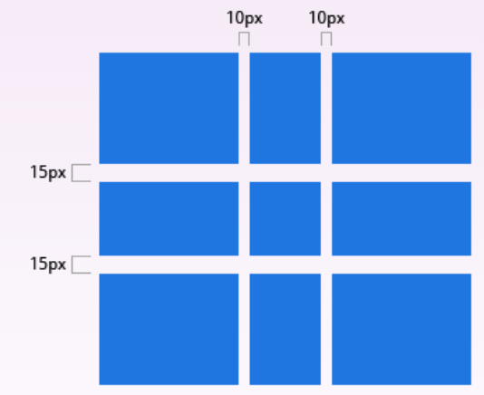
Adding a gap
You can specify the size of the gap between columns and rows
grid-column-gap: 10px;
grid-row-gap: 15px;
These are called GUTTERS. The gutters are only created between the columns/rows, not on the outer edges.
Outdated, but still in use

Slide 47
Other parent properties
justify-items
align-items
place-items
justify-content
align-content
place-content
grid-auto-columns
grid-auto-rows
grid-auto-flow
grid

Slide 48
Placing an object – child property
grid-column-start
grid-column-end
grid-row-start
grid-row-end
Can also combine grid-column: <start line> / <end line>
OR
Grid-column:<start line>/span <number of lines>

Slide 49
Other Child Properties
grid-area
justify-self
align-self
place-self

Slide 50
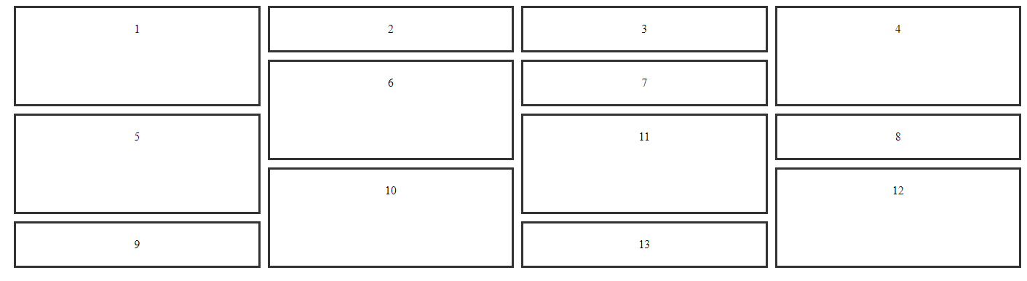
Create the following grid

